Slide 1
Global Medical Affairs Cover Sheet
Asset Name | <Generic Name: Title> | Benralizumab-Eosinophils in Sickness and in Health
Intended Use | <Reactive or Internal use> | Reactive
Approved for Distribution |  | No |  |  |  | Therapy Area | Respiratory
Asset Owner | Terri You |  |  |  |  | New or Updated | New
Document Number | ML-3034-ALL-0117 |  |  |  |  | Based on Asset (include Vault MedComms or PromoMats document number or N/A for not applicable) | NA
Approved Date | 09/19 |  | Expiration Date |  | 09/20
Technical Review/Fact Check Completed by Global Medical Information (Yes/No) |  |  |  | Yes |  | Applicable Copyright Permissions Obtained for Graphics (Yes/No) | Yes
This material is globally approved for use by AstraZeneca Medical Affairs Scientific Personnel only. The local market is responsible for interpreting, reviewing, and approving the content according to their local label, rules, and regulations.
Additional Disclaimers or Special Instructions:
External use of any of the content must be approved for release by your local nominated signatory/local medical process to ensure compliance with local regulations.
Refer to the General Properties for this asset in GMIP Content (Veeva Vault MedComms) for additional details.
Questions on this asset should be directed to asset owner.

Slide 2
Benralizumab-Eosinophils in Sickness and in Health
ML-3034-ALL-0117
09/19
09/20

Slide 3
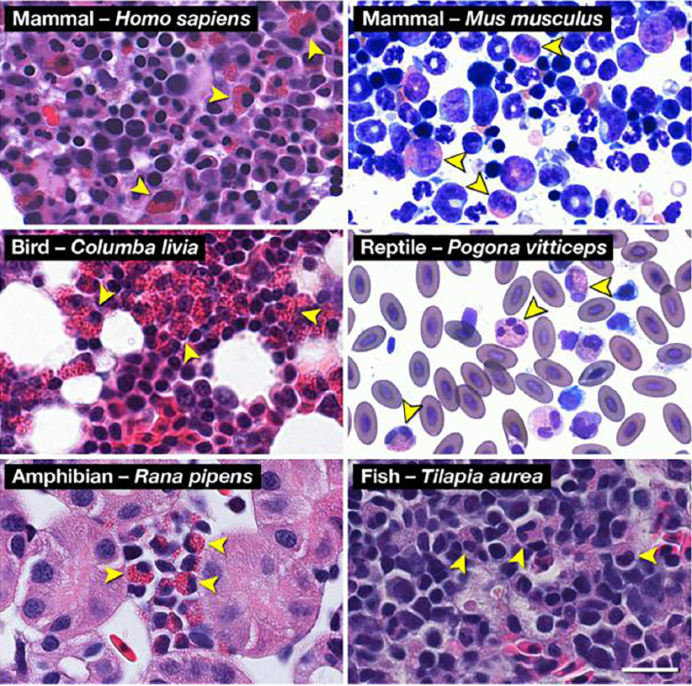

What Is an Eosinophil?^{1,2}
Terminally differentiated granulocyte
Named after eosin (dye) which stains the granules
Exists among virtually all vertebrates
Has numerous cell surface proteins and intracellular granules through which interactions are mediated
Putative physiological roles in health and disease spanning innate immune functions, anti-helminth activity, tissue inflammation, and tissue homeostasis
Eosinophil histology across classes of vertebrata
HUMAN Homo sapiens
MAMMAL
HOUSE MOUSE Mus musculus
Eosinophil structure
BIRD
PIGEON Columba livia
Roles (some putative) in Health
Anti-helminth defenses
Antiviral responses
Antibacterial responses
Antifungal immunity
Adiposity control
Mucosal surface maintenance
Tissue development, remodeling, and repair
Role in Sickness
Key contributor to inflammation and tissue injury in multiple diseases, including severe asthma
REPTILE
BEARDED DRAGON Pogona vitticeps
FISH
TILAPIA Tilapia aurea
Eosinophils in sickness
AMPHIBIAN
LEOPARD FROG Rana pipens
1. Bochner BS. Ann Allergy Asthma Immunol. 2018;121:150-155. 2. Ramirez GA, et al. BioMed Res Int. 2018;2018:9095275.
Notes:
Key points:
Eosinophils are terminally differentiated granulocytes¹
Eosinophils are named after eosin (dye) which stains the granules
Eosinophils exist among virtually all vertebrates
Shown at the right of the slide are samples demonstrating the presence of eosinophils across the 5 classes of vertebrata
Eosinophils have numerous cell surface proteins and intracellular granules through which interactions are mediated
Eosinophils have putative physiological roles in health and disease spanning innate immune functions, anti-helminth activity, tissue inflammation, and tissue homeostasis
Shown at the bottom of the slide are highlights of the role of eosinophils in health and sickness
Note to Presenter: Click on white oval text box to navigate to hyperlinked slide.
References:
Bochner BS. The eosinophil. For better or worse, in sickness and in health. Ann Allergy Asthma Immunol. 2018;121(2):150-155.
Ramirez GA, Yacoub M-R, Ripa M, et al. Eosinophils from physiology to disease: a comprehensive review. BioMed Res Int. 2018;2018:9095275.

Slide 4
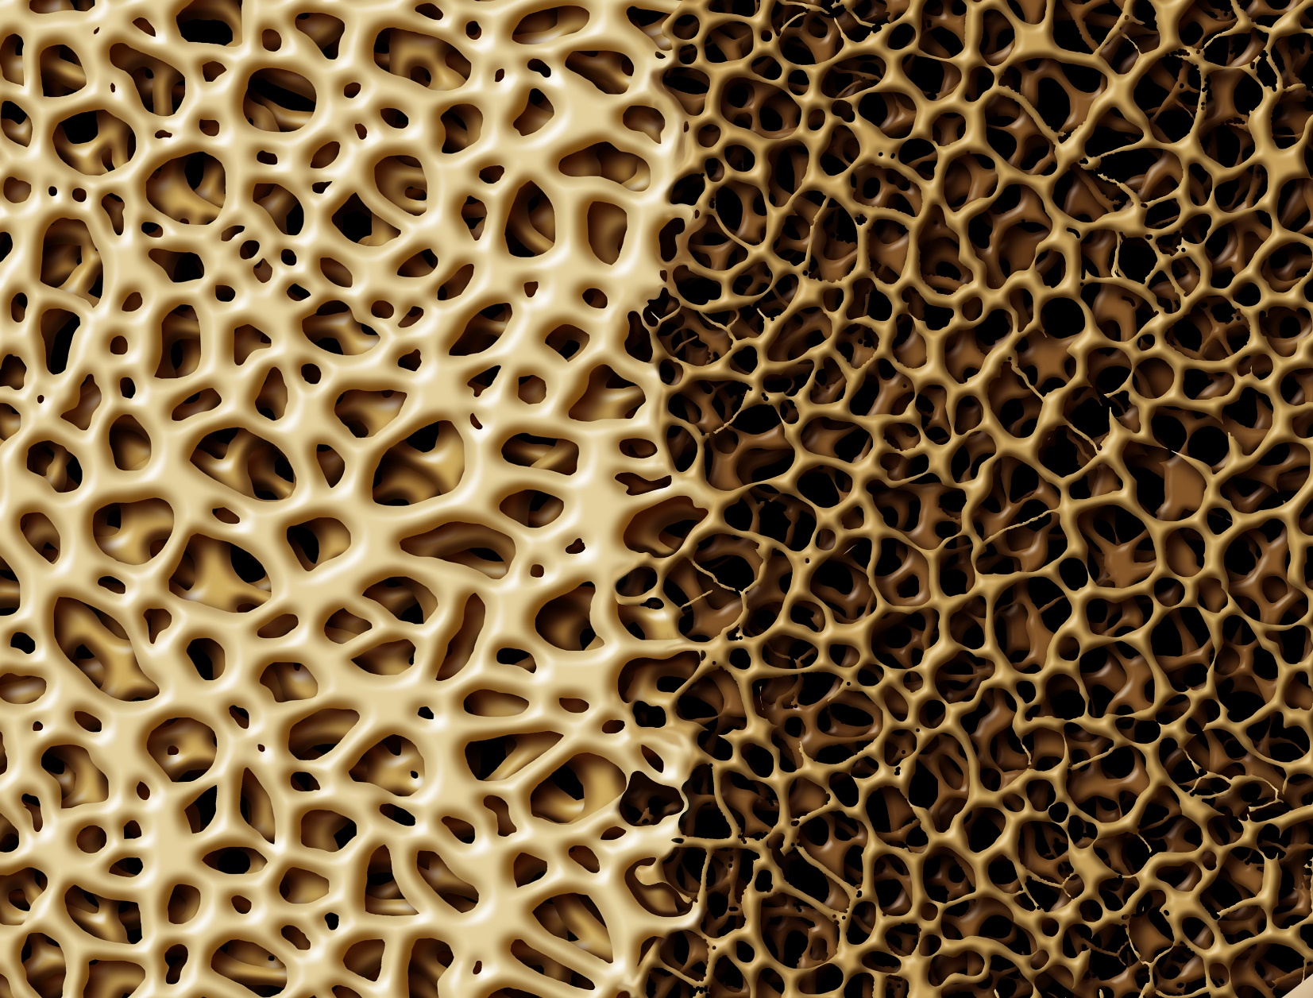
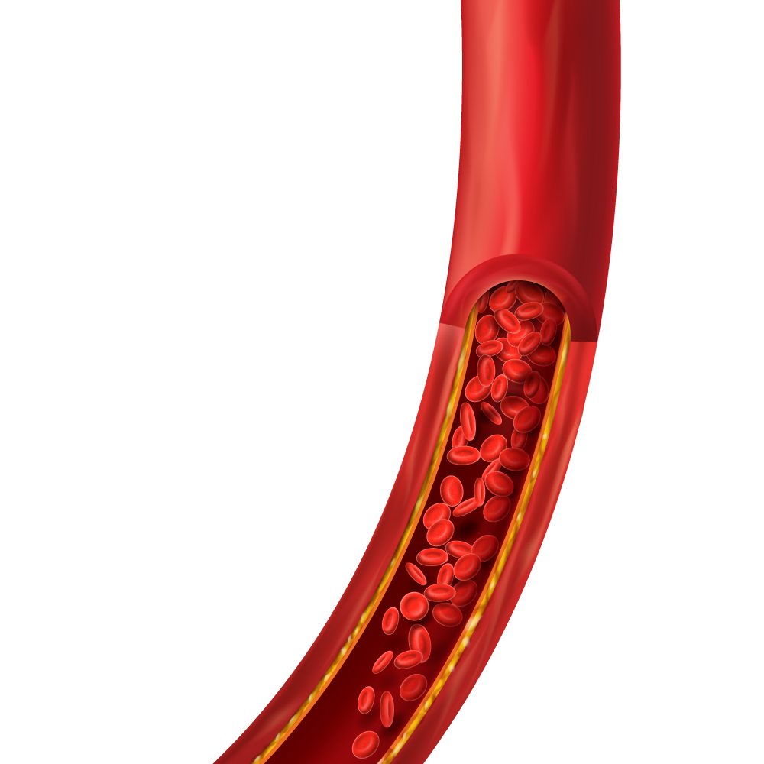



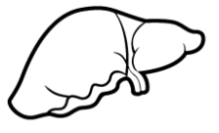
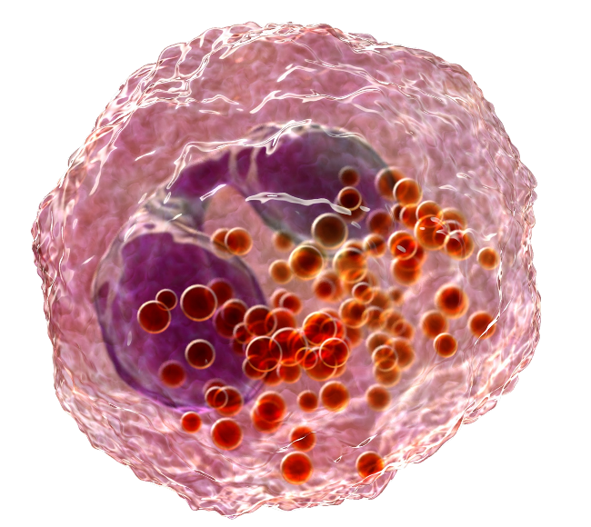


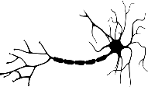







The role of eosinophils in inflammation is well characterized in humans whereas the role in homeostasis is based primarily on animal data
INFLAMMATION¹⁻³
Murine
Human
M
H
H
H
H
H
Cytokines stimulate eosinophil differentiation in the bone marrow¹⁻³
Chemokines targeting CCR3 promote eosinophil recruitment into organs and tissues¹
UPPER/LOWER GI TRACT
BLOOD VESSELS
NASAL MUCOSA
LIVER AND BILE DUCTS
H
H
H
H
IL-5
IL-3
IL-5
CCR3
HEART
LUNGS
NERVES
SKIN
GM-CSF
HOMEOSTASIS¹⁻³
Immune response modulation
Organ functional integrity
H
M
H
M
THYMUS
SPLEEN
UTERUS
MAMMARY
Last stage of eosinophil maturation in the bone marrow¹
Eosinophil release into circulation¹
Subsequent survival (~18 hour half-life in peripheral blood)⁴
M
M
M
GUT
LUNGS
ADIPOSE
The translational relevance of these concepts remains uncertain⁵
Eosinophils in asthma
1. Ramirez GA, et al. BioMed Res Int. 2018;2018:9095275. 2. Marichal T, et al. Front Med. 2017; 4:101. doi:10.3389/fmed.2017.00101. 3. Strandmark J, et al. Critical Reviews in Immunology. 2016;36(3):193-238. 4. Rosenberg HF, et al. Nat Rev Immunol. 2013;13:9-22. 5. Bochner BS. Ann Allergy Asthma Immunol. 2018;121(2):150-155.
Notes:
Key points:
Eosinophil development and maturation occur in the bone marrow over approximately a week under exposure to IL-5, IL-3, and GM-CSF¹
IL-5 promotes the final stage of eosinophil maturation and is a trigger for eosinophil migration into the circulating blood¹
IL-5 also plays a subsequent role in eosinophil survival (~18 hour half-life in peripheral blood)²
The CCR3 receptor plays a crucial role in promoting eosinophil recruitment into organs and tissues¹
Eosinophils play a role in various organs in both inflammation and homeostasis^{1,3}:
Inflammation: upper/lower GI tract, blood vessels, nasal mucosa, liver and bile ducts, heart, lungs, nerves, skin
Homeostasis:
Immune response modulation: thymus, spleen, gut, lungs
Organ functional integrity: uterus, mammary, adipose
Much of what is known about the role of eosinophils in homeostasis and health is based on data from animal studies⁴
The translational relevance of these concepts remains uncertain⁵
Note to Presenter: Click on white oval text box to navigate to hyperlinked slide.
References:
Ramirez GA, Yacoub M-R, Ripa M, et al. Eosinophils from physiology to disease: a comprehensive review. BioMed Res Int. 2018;2018:9095275.
Rosenberg HF, Dyer KD, Foster PS. Eosinophils: changing perspectives in health and disease. Nat Rev Immunol. 2013;13:9-22.
Marichal T, Mesnil C, Bureau F. Homeostatic eosinophils: characteristics and functions. Front Med. 2017;4:101. doi:10.3389/fmed.2017.00101.
Strandmark J, Rausch S, Hartmann S. Eosinophils in homeostasis and their contrasting roles during inflammation and helminth infections. Critical Reviews in Immunology. 2016;36(3):193-238.
Bochner BS. The eosinophil. For better or worse, in sickness and in health. Ann Allergy Asthma Immunol. 2018;121(2):150-155.

Slide 5




Are humans large mice?
Differences exist
(between human and mouse eosinophils)¹:
GENETIC
BIOCHEMICAL
MOLECULAR
MORPHOLOGICAL
The consequences of these differences are unknown¹
1. Lee JJ, et al. J Allergy Clin Immunol. 2012;130:572-584.
Notes:
Key points:
Differences exist between human and mouse eosinophils including genetic, biochemical, molecular, and morphological¹
The consequences of these differences are unknown¹
In the mouse, differences (including genetic, biochemical, molecular, and morphological) have been observed between inflammatory vs resident lung eosinophils, making an argument that they are distinct subsets
In humans, parenchymal eosinophils have similar morphology to peribronchial eosinophils and while some molecular differences exist, these differences were not consistent with what was observed in mice
To date, it is unclear if resident lung eosinophils exist in humans
Note to Presenter: Click on oval text boxes to navigate to hyperlinked slide.
References:
Lee JJ, Jacobsen EA, Ochkur SI, et al. Human vs. mouse eosinophils: “That which we call an eosinophil, by any other name would stain as red”. J Allergy Clin Immunol. 2012;130(2):572-584.

Slide 6




Is there more than one kind of eosinophil?
 | GENETIC | BIOCHEMICAL | MOLECULAR | MORPHOLOGICAL
MOUSE INFLAMMATORY VERSUS RESIDENT EOSINOPHILS | Differences exist | Differences exist | Differences exist
HUMAN PERIBRONCHIAL VERSUS PARENCHYMAL EOSINOPHILS* | ? | ? | Some differences | Similar
MOUSE RESIDENT EOSINOPHILS VERSUS PUTATUTVE HUMAN RESIDENT EOSINOPHILS | ? | ? | Differences exist | Differences exist
Differences exist
Morphology
Location
Differences exist
Differences exist
Differences exist
Differences exist
Some differences*
Similar
*Differences may be explained by different states of activation, for example, because tissue eosinophils were compared to sputum eosinophils.²
1. Lee JJ, et al. J Allergy Clin Immunol. 2012;130:572-584. 2. Mesnil C, et al. J Clin Invest. 2016;126(9):3279-3295.
Notes:
Key points:
Differences exist between human and mouse eosinophils including genetic, biochemical, molecular, and morphological¹
The consequences of these differences are unknown¹
In the mouse, differences (including genetic, biochemical, molecular, and morphological) have been observed between inflammatory vs resident lung eosinophils, making an argument that they are distinct subsets
In humans, parenchymal eosinophils have similar morphology to peribronchial eosinophils and while some molecular differences exist, these differences were not consistent with what was observed in mice
To date, it is unclear if resident lung eosinophils exist in humans
Note to Presenter: Click on oval text boxes to navigate to hyperlinked slide.
References:
Lee JJ, Jacobsen EA, Ochkur SI, et al. Human vs. mouse eosinophils: “That which we call an eosinophil, by any other name would stain as red”. J Allergy Clin Immunol. 2012;130(2):572-584.
Mesnil C, Raulier S, Paulissen G, et al. Lung-resident eosinophils represent a distinct regulatory eosinophil subset. J Clin Invest. 2016;126(9):3279-3295.

Slide 7
Are There Consequences of Eosinophil Depletion?

Slide 8
Eosinophil Depletion in Genetically Modified Mice
MURINE
Eosinophil-deficient mice (e.g., DdblGATA and PHIL) have profound and lifelong eosinophil deficiency with no obvious aberrant phenotype¹⁻³
No apparent differences in pathogen-mediated responses vs wild-type mice, despite being exposed to varying degrees of cleanliness⁴
They have not spontaneously developed carcinomas or other malignant tumors⁴
No apparent changes in health, fertility, ability to nurse, and vitality relative to eosinophil-sufficient wild-type animals⁴
These observations suggests overlapping and redundant eosinophil-independent pathways⁴
1. Bochner BS. Ann Allergy Asthma Immunol. 2018;121(2):150-155. 2. Humbles AA, et al. Science. 2004(5691);305:1776-1779. 3. Lee JJ, et al. Science. 2004;305(5691):1773-1776. 4. Gleich GJ, et al. Allergy. 2013;68(7):829-835.
Notes:
Key points:
Eosinophil-deficient mice (e.g., DdblGATA and PHIL) have profound and lifelong eosinophil deficiency with no obvious aberrant phenotype¹⁻³
No display of significant differences in pathogen-mediated responses vs wild-type mice, despite being exposed to varying degrees of cleanliness⁴
They have not spontaneously developed carcinomas or other malignant tumors⁴
No apparent display of overt changes in health, fertility, ability to nurse, and vitality relative to eosinophil-sufficient wild-type animals with the exception of not having this lineage as a product of the bone marrow⁴
Suggests overlapping and redundant eosinophil-independent pathways⁴
The observation that eosinophil-deficient mice do not display any characteristic syndrome or failure of their health is strong evidence that under usual laboratory conditions the eosinophil does not play a critical role in maintenance of well-being of mammals⁴
References:
Bochner BS. The eosinophil. For better or worse, in sickness and in health. Ann Allergy Asthma Immunol. 2018;121(2):150-155.
Humbles AA, Lloyd CM, McMillan SJ, et al. A critical role for eosinophils in allergic airways remodeling. Science. 2004;305(5691):1776-1779.
Lee JJ, Dimina D, Macias MP, et al. Defining a link with asthma in mice congenitally deficient in eosinophils. Science. 2004;305(5691):1773-1776.
Gleich GJ, Klion AD, Lee JJ, et al. The consequences of not having eosinophils. Allergy. 2013;68(7):829-835.
7

Slide 9
Eosinophil Depletion in Humans
HUMAN
Eosinophil deficiency due to immunodeficiency or IgG-mediated eosinophil precursor destruction
Eosinophil deficiency in patients with comorbid allergic diseases
Drug-induced reduction/depletion of eosinophils (i.e., monoclonal antibodies to IL-5)
No distinguishing abnormalities related to eosinophil reduction
Spectrum of adverse events did not differ appreciably from placebo in clinical trials
These findings suggest that:
“Eosinophil deficiency itself is benign (aside from the associated immune deficiencies and allergic diseases) and that the absence of the eosinophil
for long periods of time does not confer any clinically distinctive consequences.”
Gleich GJ, et al. Allergy. 2013;68(7):829-835.
Notes:
Key points:
No distinguishing abnormalities related to eosinophil reduction have been observed in patients with:
Eosinophil deficiency due to immunodeficiency or IgG-mediated eosinophil precursor destruction
Eosinophil deficiency in patients with comorbid allergic diseases
In clinical trials, drug-induced reduction/depletion of eosinophils (i.e., monoclonal antibodies to IL-5) resulted in a spectrum of adverse events that did not differ appreciably from placebo in humans
These findings suggest that: “Eosinophil deficiency itself is benign (aside from the associated immune deficiencies and allergic diseases) and that the absence of the eosinophil for long periods of time does not confer any clinically distinctive consequences.”
Reference:
Gleich GJ, Klion AD, Lee JJ, et al. The consequences of not having eosinophils. Allergy. 2013;68(7):829-835.

Slide 10
Benralizumab Phase Asthma III Clinical Trial Safety Data: Eosinophil Depletion Over Two Years
HUMAN
Study | Safety Results
Phase III Placebo-Controlled Asthma Exacerbation Studies SIROCCO^{1,2} (N=1204; treatment period, 48 weeks) CALIMA^{3,4} (N=1306; treatment period, 56 weeks) Phase III Placebo-Controlled Asthma OCS-sparing Study ZONDA^{5,6} (N=220; treatment period, 28 weeks) | The frequency of AEs and SAEs was similar in patients with severe asthma who were treated with benralizumab 30 mg administered SC Q4W or Q4W for the first 3 doses and then Q8W to those in patients who received placebo The most commonly reported AEs regardless of causality included nasopharyngitis, asthma, and upper respiratory tract infections The incidence of severe/serious infections and malignant neoplasms was balanced between Tx and placebo
Long-term Safety and Efficacy Extension Study BORA^{7,8} (N=1576; treatment period, 56 weeks) | The safety and tolerability profile in the second year of benralizumab treatment was similar to that observed in the placebo-controlled SIROCCO and CALIMA studies, with no increase in the frequency of overall AEs, SAEs, and AEs leading to discontinuation Rates of serious infections and newly diagnosed malignancies were low and similar to those observed in the primary studies No reports of helminth parasitic infections
In the second year of benralizumab treatment in severe asthma patients, no new safety signals that might be associated with long-term depletion of eosinophils were observed⁷
AE = adverse events; OCS = oral corticosteroid; Q4W = every 4 weeks; Q8W = every 8 weeks; SAE = serious adverse event.
1. Bleecker ER, et al. Lancet. 2016;388:2115-2127. 2. Bleecker ER, et al. Supplementary appendix. Lancet. 2016;388:2115-2127. 3. FitzGerald JM, et al. Lancet. 2016;388:2128-2141. 4. FitzGerald JM, et al. Supplementary appendix. Lancet. 2016;388:2128-2141. 5. Nair P, et al. N Engl J Med. 2017;376(25):2448-2458. 6. Nair P, et al. Supplementary appendix. N Engl J Med. 2017;376(25):2448-2458. 7. Busse WW, et al. Lancet Respir Med. 2018;7:46-59. 8. Busse WW, et al. Supplementary appendix. Lancet Respir Med. 2018;7:46-59.
Notes:
Key points:
Benralizumab Phase III clinical trials safety results in the setting of eosinophil depletion over 2 years
Safety results from Phase III studies (SIROCCO, CALIMA, and ZONDA) demonstrated¹⁻⁶:
The frequency of AEs and SAEs, regardless of causality, was similar in patients with severe asthma who were treated with benralizumab 30 mg administered SC Q4W or Q4W for the first 3 doses and then Q8W to those in patients who received placebo
The most commonly reported AEs regardless of causality included nasopharyngitis, asthma, and upper respiratory tract infections
Across the study groups, no more than 4% of patients discontinued treatment because of an AE
Safety results from a long-term extension study (BORA) demonstrated⁷⁻⁸:
The safety and tolerability profile in the second year of benralizumab treatment was similar to that observed in the placebo-controlled SIROCCO and CALIMA studies, with no increase in the frequency of overall AEs, SAEs, and AEs leading to discontinuation
Rates of serious infections and newly diagnosed malignancies were low and similar to those observed in the primary studies
No reports of helminth parasitic infections
In the second year of benralizumab treatment, no new safety signals that might be associated with long-term depletion of eosinophils were observed⁷
References:
Bleecker ER, FitzGerald M, Chanez P, et al. Efficacy and safety of benralizumab for patients with severe asthma uncontrolled with high-dosage inhaled corticosteroids and long-acting β₂-agonists (SIROCCO): a randomised, multicentre, placebo-controlled phase 3 trial. Lancet. 2016;388:2115-2127.
Bleecker ER, FitzGerald M, Chanez P, et al. Supplementary appendix. Lancet. 2016;388:2115-2127.
FitzGerald JM, Bleecker ER, Nair P, et al. Benralizumab, an anti-interleukin-5 receptor α monoclonal antibody, as add-on treatment for patients with severe, uncontrolled, eosinophilic asthma (CALIMA): a randomised, double-blind, placebo-controlled phase 3 trial. Lancet. 2016;388:2128-2141.
FitzGerald JM, Bleecker ER, Nair P, et al. Supplementary appendix. Lancet. 2016;388:2128-2141.
Nair P, Wenzel S, Rabe KF, et al. Oral glucocorticoid–sparing effect of benralizumab in severe asthma. N Engl J Med. 2017;376(25):2448-2458.
Nair P, Wenzel S, Rabe KF, et al. Supplementary appendix. N Engl J Med. 2017;376(25):2448-2458.
Busse WW, Bleeker ER, FitzGerald JM, et al. Long-term safety and efficacy of benralizumab in patients with severe, uncontrolled asthma: 1-year results from the BORA phase 3 extension trial. Lancet Respir Med. 2018;7:46-59.
Busse WW, Bleeker ER, FitzGerald JM, et al. Supplementary appendix. Lancet Respir Med. 2018;7:46-59.

Slide 11
ALIZE Study* Summary
HUMAN
There was no effect on antibody response to influenza vaccination in patients who also received benralizumab compared to placebo
Improvement in ACQ-6 scores was observed in both groups
There was a similar occurrence of AEs in the benralizumab and placebo groups (43.1% and 44.2%; respectively)
Evaluated whether benralizumab, which depletes eosinophils, might interfere with the influenza vaccine antibody response in adolescents and young adults with moderate to severe asthma
*Randomized, double-blind, placebo-controlled trial of patients aged 12-21 years with uncontrolled asthma receiving treatment with medium-to-high dosage inhaled corticosteroids/long-acting β2 agonists. Patients were randomized to treatment with benralizumab 30 mg subcutaneously every 4 weeks for three doses (n=51) or placebo (n=52). Patients also received one dose of quadrivalent influenza vaccine intramuscularly at Week 8. The primary outcome was effect on the humoral immune response following seasonal influenza virus vaccination.
ACQ-6 = Asthma Control Questionnaire-6; GMFR = geometric mean fold rise; HAI = hemagglutination-inhibition; MN= microneutralization.
Zeitlin PL, et al. J Asthma Allergy. 2018;11:181-192.
Notes:
Key points:
ALIZE was a Phase IIIb randomized, double-blind, parallel-group, placebo-controlled trial of patients aged 12-21 years receiving medium- to high-dosage ICS/LABA (N=103)
This study evaluated whether benralizumab, which depletes eosinophils, might interfere with the influenza vaccine antibody response in adolescents and young adults with moderate to severe asthma
There was no effect on antibody response to influenza vaccination in patients who also received benralizumab compared to placebo
Post-dose, strain-specific HAI and MN antibody GMFRs at Week 12 showed no consistent differences in patients receiving benralizumab compared to placebo
Increases in HAI and MN antibody titers ≥4-fold were similar in the benralizumab and placebo groups from Week 8 to Week 12
HAI antibody titers ≥320 at Week 2 were higher for influenza A strains compared to B strains in both groups
Improvement in ACQ-6 scores was observed in both groups
There was a similar occurrence of AEs in the benralizumab and placebo groups (43.1% and 44.2%; respectively).
ALIZE Study Design:
Phase IIIb, randomized, double-blind, placebo-controlled trial of patients aged 12-21 years with uncontrolled asthma receiving treatment with medium-to-high dosage inhaled corticosteroids/long-acting β2 agonists. Uncontrolled asthma was defined as one or more of the following: Asthma Control Questionnaire 6 score ≥1.5, peak expiratory flow of 60-80% predicted, ≥1 exacerbation requiring oral corticosteroids in the previous year, and/or persistent symptoms in the previous 2-4 weeks.
Patients were randomized to treatment with benralizumab 30 mg subcutaneously every 4 weeks for three doses (n=51) or placebo (n=52). Patients also received one dose of quadrivalent influenza vaccine intramuscularly at Week 8.
The primary outcome, effect on the humoral immune response following seasonal influenza virus vaccination, was assessed by post-dose, strain-specific hemagglutination inhibition (HAI) antibody geometric mean fold rises (GMFRs) from Week 8 to Week 12; post-dose, strain-specific HAI antibody geometric mean titers (GMTs) at Week 12; percentage of patients experiencing a post-dose, strain-specific HAI antibody response at Week 12 (defined as a ≥4-fold rise in HAI antibody titer from Week 8 to Week 12); and percentage of patients with a post-dose, strain-specific HAI antibody titer ≥40 at Week 12.
Reference:
Zeitlin PL, Leong M, Cole J, et al. Benralizumab does not impair antibody response to seasonal influenza vaccination in adolescent and young adult patients with moderate to severe asthma: results from the Phase IIIb ALIZE trial. J Asthma Allergy. 2018;11:181-192.

Slide 12
Conclusions: What We Do Know
In mice^{1,2}
Evidence exists for functionally distinctive inflammatory (recruited) and immunoregulatory/homeostastatic (resident) EOS in the mouse lung
Exposure of mice to α-IL-5 antibody significantly decreases inflammatory eosinophils but has no apparent impact on resident eosinophils
Observations from engineered mouse strains that do not produce eosinophils suggest that the eosinophil does not play a critical role in maintenance of well-being of mammals
In humans¹⁻⁶
Lung resident eosinophils have not been functionally characterized in humans; however, evidence supports the existence of positionally and phenotypically distinct subsets of lung eosinophils
No new safety signals that might be associated with long-term depletion of eosinophils were observed in patients with severe asthma during the second year of treatment with benralizumab.
1. Mesnil C, et al. J Clin Invest. 2016;126(9):3279-3295. 2. Gleich GJ, et al. Allergy. 2013;68(7):829-835. 3. Klion A. F1000 Research. 2017;6:(doi:10.12688/f1000research.11133.1). 4. Bleecker ER, et al. Supplementary appendix. Lancet. 2016;388:2115-2127. 5. FitzGerald JM, et al. Supplementary appendix. Lancet. 2016;388:2128-2141. 6. Nair P, et al. Supplementary appendix. N Engl J Med. 2017;376(25):2448-2458. 7. Busse WW, et al. Supplementary appendix. Lancet Respir Med. 2018;7:46-59.
Notes:
Key points:
What we do know in mice:
Inflammatory and resident lung eosinophils are distinct, terminally differentiated subsets¹
Inflammatory lung eosinophils have a proinflammatory role whereas resident eosinophils have an immunoregulatory/ homeostasis role¹
Induced allergy/presence of IL-5 results in significant recruitment of inflammatory eosinophils but has no impact on resident eosinophils¹
Exposure to α-IL-5 significantly decreases inflammatory eosinophils but has no impact on resident eosinophils¹
Data suggest that the eosinophil does not play a critical role in maintenance of well-being of mammals²
What we do know in humans:
Lung resident eosinophils have not been functionally characterized in humans; however, evidence may support the existence of positionally and phenotypically distinct subsets of lung eosinophils^{1,3}
It is unclear whether the parenchymal eosinophils are resident eosinophils or inflammatory eosinophils in a different state of activation¹
Absence of eosinophils does not confer any clinically distinctive consequences beyond what can be explained by absence of other immune cells²
In the second year of benralizumab treatment, no new safety signals that might be associated with long-term depletion of eosinophils were observed⁴⁻⁷
References:
Mesnil C, Raulier S, Paulissen G, et al. Lung-resident eosinophils represent a distinct regulatory eosinophil subset. J Clin Invest. 2016;126(9):3279-3295.
Gleich GJ, Klion AD, Lee JJ, et al. The consequences of not having eosinophils. Allergy. 2013;68(7):829-835.
Klion A. Recent advances in understanding eosinophil biology [version 1; referees: 2 approved]. F1000 Research. 2017;6:(doi:10.12688/f1000research.11133.1).
Bleecker ER, FitzGerald M, Chanez P, et al. Supplementary appendix. Lancet. 2016;388:2115-2127
FitzGerald JM, Bleecker ER, Nair P, et al. Supplementary appendix. Lancet. 2016;388:2128-2141.
Nair P, Wenzel S, Rabe KF, et al. Supplementary appendix. N Engl J Med. 2017;376(25):2448-2458.
Busse WW, Bleeker ER, FitzGerald JM, et al. Supplementary appendix. Lancet Respir Med. 2018;7:46-59.

Slide 13

Conclusions: What We Don’t Know
In humans
If and how mouse data translates into humans
If functional regulatory lung eosinophils occur in humans
The role of IL-5 in differentiation of potential resident and inflammatory eosinophils in humans
Whether there are differences in IL-5 induced signal transduction pathways in different types of eosinophils
Notes:
Key points:
What we don’t know in humans:
How mouse data translates into humans across various associations observed in mice
If resident lung eosinophils exist in humans
Whether exposure to anti-IL-5 has any impact on lung resident eosinophils
The role of IL-5 in differentiation of resident and inflammatory eosinophils in humans
The contribution of IL-5 to resident and inflammatory eosinophil differentiation of the signal transduction pathways downstream of the IL-5 receptor in human
Whether both resident and inflammatory eosinophil express the IL-5 receptor to the same extent in human

Slide 14
Appendix

Slide 15
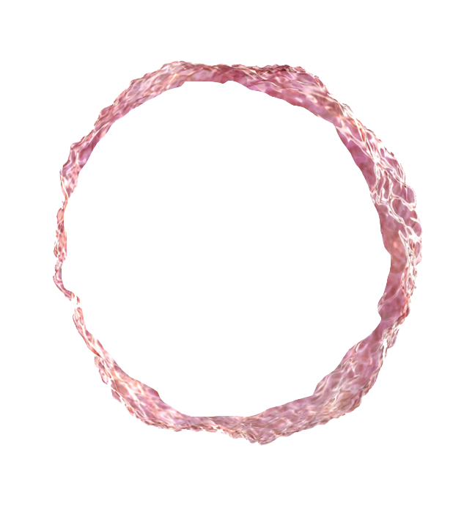

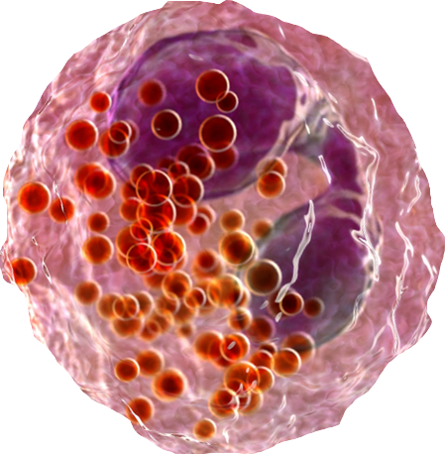
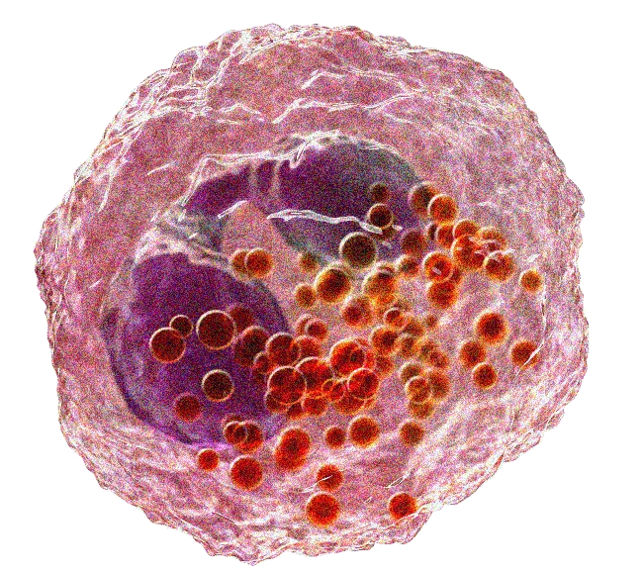
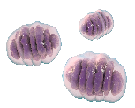
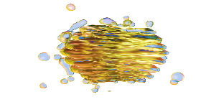
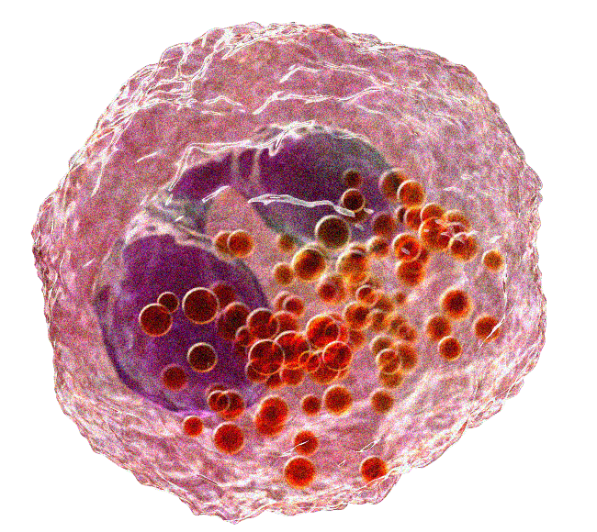

Eosinophils Interact With Their Environment Through Internal Contents and Many Surface Receptors^{1,2}
Nucleus
1. Rosenberg H, et al. Nat Rev Immunol. 2013;13(1):9-22. 2. Diny NL, et al. Front Immunol. 8:484. doi:10.3389/fimmu.2017.00484.
Notes:
Key point:
Eosinophils interact with their environment through internal contents and many surface receptors^{1,2}
[CLICK] to advance slide to show inside of cell.
References:
Rosenberg HF, Dyer KD, Foster PS. Eosinophils: changing perspectives in health and disease. Nat Rev Immunol. 2013;13:9-22.
Diny NL, Rose NR, Čiháková D. Eosinophils in autoimmune diseases. Front Immunol. 8:484. doi:10.3389/fimmu.2017.00484.

Slide 16
Eosinophils Interact With Their Environment Through Internal Contents and Many Surface Receptors^{1,2}
INTERNAL CONTENTS
SURFACE RECEPTORS
Mitochondria
Cytokine and growth factor receptors
IL-2R, IL-3R, IL-4R, IL-5R, IL-9R, IL-10R, IL-13R, IL-17R, IL-23R, IL-27R, IL-31R, IL-33R, TSLPR, GM-CSFR, KIT, IFNγR, TGFβR
Lipid bodies
Leukotrienes
Thromboxane
Prostaglandins
15-hydroxyeicosatetraenoic acid
Platelet-activating factor
Nucleus
Chemokine receptors
CCR1, CCR3, CCR4, CCR5, CCR6, CCR8, CCR9, CXCR2, CXCR3, CXCR4, FPR1, C5aR, C3aR
Golgi apparatus
Granules
Cationic proteins: MBP, EPX, ECP, EDN
Cytokines: IL-2, IL-3, IL-4, IL-5, IL-6, IL-10, IL-12, IL-13, IFNγ, GM-CSF, TGFβ, TNF
Growth factors: NGF, PDGF, SCF, VEGF, EGF, APRIL
Chemokines: CCL3, CCL5, CCL7, CCL8, CCL11, CCL13, CXCL1, CXCL10, CXCL12
Enzymes
Fc receptors
FcαR, FcγRI-III, FcƐRI-II
Adhesion receptors
LFA1 (CD11a–CD18), CR3 (CD11b–CD18), CR4 (CD11c–CD18), VLA4 (CD49d–CD29), CD44, CD62L, PSGL1, CD34
Receptors for lipid mediators
Platelet-activating factor receptor, prostaglandin D2 receptor 1,2, prostaglandin E2 receptor 2,4, leukotriene B4 receptor
Sombrero vesicles
Return to presentation
Abbreviations are defined in the speaker notes.
1. Rosenberg H, et al. Nat Rev Immunol. 2013;13(1):9-22. 2. Diny NL, et al. Front Immunol. 8:484. doi:10.3389/fimmu.2017.00484.
Notes:
Key points:
Internal contents of eosinophils include: mitochondria, lipid bodies, golgi apparatus, granules, and sombrero vesicles^{1,2}
Eosinophil surface receptors include: cytokine and growth factor receptors, chemokine receptors, Fc receptors, adhesion receptors, and receptors for lipid mediators^{1,2}
Eosinophils are equipped with features that promote interactions with their environment¹
Eosinophils release the contents of their specific granules in response to external stimuli¹
Some granule contents are released via membrane‑bound vesicles known as eosinophil sombrero vesicles¹
Human eosinophils also synthesize lipid mediators for release in cytoplasmic lipid bodies and store Charcot–Leyden crystal protein (CLC/galectin-10) in primary granules¹
Eosinophils express a wide variety of receptors that modulate adhesion, growth, survival, activation, migration, and pattern recognition¹
Among the main receptors defining their unique biology are IL-5Rα, CCR3, and Siglec-8/Siglec-F¹
Mouse eosinophils are known to differ from human eosinophils in important ways¹
Unlike human eosinophils, mouse eosinophils do not express CLC/galectin-10 or Fcε receptor 1 (FcεR1) and have divergent homologs of SIGLEC‑8 and the granule ribonucleases eosinophil‑derived neurotoxin (EDN) and eosinophil cationic protein (ECP) ¹
Note to Presenter: Click on ‘Return to Presentation’ text box at bottom right corner to return to original slide.
References:
Rosenberg HF, Dyer KD, Foster PS. Eosinophils: changing perspectives in health and disease. Nat Rev Immunol. 2013;13:9-22.
Diny NL, Rose NR, Čiháková D. Eosinophils in autoimmune diseases. Front Immunol. 8:484. doi:10.3389/fimmu.2017.00484.
Abbreviations: APRIL = a proliferation‑inducing ligand; CCL = CC‑chemokine ligand; CCR = CC‑chemokine receptor; CXCL = CXC‑chemokine ligand; CXCR = CXC‑chemokine receptor; ECP = eosinophil cationic protein; EDN = eosinophil-derived neurotoxin; EGF = epidermal growth factor; EPX = eosinophil peroxidase; FPR1 = formyl peptide receptor 1; GM‑CSF = granulocyte-macrophage colony‑stimulating factor; IFN = interferon; IL = interleukin; LFA = lymphocyte function-associated antigen; MBP = major basic protein; NGF = nerve growth factor; PSGL1 = P-selectin glycoprotein ligand-1; SCF = stem cell factor; TGF = transforming growth factor; TLR = Toll‑like receptor; TNF = tumor necrosis factor; TSLPR = thymic stromal lymphopoietin receptor; VEGF = vascular endothelial growth factor; VLA4 = very late activation antigent-4.

Slide 17

Eosinophils are a Key Mediator of Airway Inflammation in Asthma
Depending on the definition, elevated eosinophil counts are observed in ~50-70% of asthma patients¹⁻³
One-half to two-thirds of patients with severe asthma have persistent large airway tissue eosinophils⁴
Eosinophils contribute to airway obstruction and inflammation and can cause progressive airway damage^{5,6}
Eosinophils can provoke airway narrowing and tissue remodeling and are strongly associated with asthma severity^{1,5,7}
1. Carr TF, et al. World Allergy Organ J. 2016;9:21. 2. Douwes J, et al. Thorax. 2002;57(7):643-648. 3. Tran TN, et al. Ann Allergy Asthma Immunol. 2016;116(1):37-42. 4. Wenzel S. Am J Respir Crit Care Med. 2005;172(2):149-160. 5. Trivedi SG, Lloyd CM. Cell Mol Life Sci. 2007;64(10):1269-1289. 6. de Groot JC, et al. ERJ Open Res. 2015;1:1-11. 7. Walford HH, et al. J Asthma Allergy. 2014;7;53-65.
Notes:
Key points:
Depending on the definition, elevated eosinophil counts are observed in ~50-70% of asthma patients¹⁻³
One-half to two-thirds of patients with severe asthma have persistent large airway tissue eosinophils⁴
Eosinophils contribute to airway obstruction and inflammation and can cause progressive airway damage^{5,6}
Eosinophils can provoke airway narrowing and tissue remodeling and are strongly associated with asthma severity^{1,5,7}
Notes:
Late-onset, eosinophilic asthma is often severe and nonallergic⁸
Recent evidence suggests that the mechanisms producing the eosinophilic phenotype may be separate from allergic mechanisms⁹
Innate lymphoid cells may drive eosinophilic inflammation in an allergen-independent manner by producing high levels of cytokines, such as IL-5 and IL-13, upon exposure to viruses, fungal allergens, or air pollutants⁹
Eosinophil cut off definitions for eosinophilic asthma:
In Carr TF, et al, a specific eosinophil cut off for eosinophilic asthma is not defined. It is only stated that elevated eosinophil levels are seen in approximately half of individuals with asthma¹
In Douwes J et al, cut off values used to define eosinophilic asthma were the same as those reported in the original studies (2–4%) or, when the authors did not define a cut off level, 2% was used. Overall, among publications from 1995 to 2001, the weighed mean proportion of children and adults with eosinophilic asthma was 51%²
NHANES: Based on data from the 2005 to 2006 annual survey of a nationally representative sample of a noninstitutionalized United States population in adult patients with asthma (aged 18-64 years) identified based on the participants’ self-report, eosinophilic asthma was defined as a blood eosinophil cutoff point of ≥150 cells/μL. Of the 310 adult patients, 69% had a blood eosinophil level ≥150 cells/μL³
Although a standard definition has not emerged, peripheral blood eosinophil counts of ≥150 cells/μL, ≥300 cells/μL or ≥400 cells/μL have been used in registration trials of biologic agents to describe eosinophilic asthma
References:
Carr TF, Berdnikovs S, Simon HU, et al. Eosinophilic bioactivities in severe asthma. World Allergy Organ J. 2016;9:21.
Douwes J, Gibson P, Pekkanen J, et al. Non-eosinophilic asthma: importance and possible mechanisms. Thorax. 2002;57(7):643-648.
Tran TN, Zeiger RS, Peters SP, et al. Overlap of atopic, eosinophilic, and TH2-high asthma phenotypes in a general population with current asthma. Ann Allergy Asthma Immunol. 2016;116:37-42.
Wenzel S. Severe Asthma in Adults. Am J Respir Crit Care Med. 2005;172(2):149-160.
Trivedi SG, Lloyd CM. Biomedicine & diseases: review eosinophils in the pathogenesis of allergic airways disease. Cell Mol Life Sci. 2007;64(10):1269-1289.
de Groot JC, ten Brinke A, Bel EHD. Management of the patient with eosinophilic asthma: a new era begins. ERJ Open Res. 2015;1:1-11.
Walford HH, Doherty TA. Diagnosis and management of eosinophilic asthma: a US perspective. J Asthma Allergy. 2014;7;53-65. .
Brusselle GG, Maes T, Bracke KR. Eosinophils in the spotlight: eosinophilic airway inflammation in nonallergic asthma. Nat Med. 2013;19(8):977-979.
de Groot JC, Storm H, Amelink M, et al. Clinical profile of patients with adult-onset eosinophilic asthma. ERJ Open Res. 2016;2(2):1-8.
Skolnik NS, Carnahan SP. Primary care of asthma: new options for severe eosinophilic asthma. Curr Med Res Opin. 2019;35(7):1309-1318.

Slide 18
Blood Eosinophil Levels Correlate With Asthma Exacerbations and Control
Severe Exacerbations
Acute Respiratory Events
Overall Asthma Control
Adjusted RR*
Adjusted RR*
Adjusted OR*
>1000 cells per µL (n=1,019)
901–1000 cells per µL (n=1,019)
801–900 cells per µL (n=947)
701–800 cells per µL (n=1,631)
601–700 cells per µL (n=2,726)
501–600 cells per µL (n=4,928)
401–500 cells per µL (n=8,659)
301–400 cells per µL (n=15,030)
201–300 cells per µL (n=25,882)
Peripheral Blood Eosinophils
↑ risk for acute respiratory events
↑ OR of asthma control
↑ risk for severe exacerbations
0.5
0.7
1.0
1.5
2.0
2.5
0.5
0.7
1.0
1.5
2.0
2.5
0.3
0.5
0.7
1.0
1.5
2.0
*Data from medical records of asthmatics aged 12–80 years with 2 years of continuous records, including 1 year before (baseline) and 1 year after (outcome) their most recent eosinophil count. Patients assigned to 9 eosinophil count categories compared with a reference category of 200 cells per μL or less (n=68,407). Adjusted for age, sex, body-mass index, smoking status, and Charlson comorbidity index score.
Acute respiratory events = an asthma-related hospital attendance or admission or accident and emergency attendance, prescription for acute OCS, or prescription for antibiotics in conjunction with an asthma-related primary care consultation; OR = odds ratio; overall asthma control = the absence of any acute respiratory event or asthma-related outpatient department visit with an average daily dose of ≤200 μg salbutamol or ≤500 μg terbutaline; RR = rate ratio; severe exacerbations = an asthma-related hospitalization, attendance at an accident and emergency department, or a prescription for acute OCS.
Price DB, et al. Lancet Respir Med. 2015;3:849-858.
Return to presentation
Notes:
Key points:
Blood eosinophil levels have been correlated with:
An increased risk for severe exacerbations
An increased risk for acute respiratory events
An increased OR of asthma control
Note to Presenter: Click on ‘Return to Presentation’ text box at bottom right corner to return to original slide.
Reference:
Price DB, Rigazio A, Campbell JD, et al. Blood eosinophil count and prospective annual asthma disease burden: a UK cohort study. Lancet Respir Med. 2015;3:849-858.

Slide 19
Eosinophils in Sickness¹
Total eosinophil count (cells/μL)
Eosinophilia (Laboratory defined)
Hypereosinophilia (Typical range)
0
500
1,500
ALLERGIC RHINITIS ● EoE ● URTICARIA ● FOOD ALLERGY
ASTHMA ● ATOPIC DERMATITIS ● BULLOUS PEMPHIGOID
NASAL POLYPOSIS ● EOSINOPHILIC GASTRITIS ● ABPA EP ● EGPA ● DRESS ● HELMINTH INFECTIONS
HES ● EOSINOPHILIC LEUKEMIAS ● LYMPHOMAS
EoE = eosinophilic esophagitis; ABPA = allergic bronchopulmonary aspergillosis; EP = eosinophilic pneumonia; EGPA = eosinophilic granulomatosis with polyangiitis; DRESS = drug reaction with eosinophilia and systemic syndrome; HES = hypereosinophilic syndrome
1. Bochner BS. Ann Allergy Asthma Immunol. 2018;121:150-155.
Return to presentation
Notes:
Key points:
Potential diagnoses at various levels of total eosinophil blood count at presentation are shown.
Note to Presenter: Click on ‘Return to Presentation’ text box at bottom right corner to return to original slide.
Reference:
Bochner BS. The eosinophil. For better or worse, in sickness and in health. Ann Allergy Asthma Immunol. 2018;121:150-155.

Slide 20
Differences Exist Between Human and Mouse Eosinophils^{1,2}
Cell Surface Phenotype
Granule Proteins
Mouse (human) | Eosinophils* | Neutrophils | Dendritic cells | Macrophages | MDSCs
F4/80 (EMR1)
Siglec-F (Siglec-8)
CCR3 (CCR3)
Gr-1 (Ly6-G)
CD11b (CD11b)
CD86 (CD86)
MHC II (HLA-DR)
MBP-1 | Transcribed from multiple promoters
 | Expressed in leukocytes beyond eosinophils
 | Expressed in non-leukocytes
 | Highly cationic
MBP-2 | Highly cationic
EARs | Presence of ECP
 | Presence of EDN
 | All EARs nominally cationic
 | (Mouse EARs are distant paralogous genes)
EPX | Presence of EPX
CLC | Presence of CLC
Increasing expression†
No → low expression†
Mouse
Human
CLC = Charcot-Leyden crystal protein; EARs = eosinophil associated ribonucleases; ECP = eosinophil cationic protein; EDN = eosinophil derived neurotoxin; EPX = eosinophil peroxidase; MBP = major basic protein; MDSCs = myeloid-derived suppressor cells.
*Activated eosinophils; †Shown are the highest levels of expression achieved within each myeloid cell class.
1. Lee JJ, et al. J Allergy Clin Immunol. 2012;130:572-584. 2. Lee JJ, et al. Supplementary appendix. J Allergy Clin Immunol. 2012;130:572-584.
Return to presentation
Notes:
Key points:
Shown are some of the common cell surface markers for eosinophils in humans and/or mice
For each cell surface phenotype, we can see the degree of expression in eosinophils as well as other myeloid cells
In general, a certain degree of heterogeneity exists across these cell surface phenotypes
On the right are characteristics of eosinophil granule proteins in humans and/or mice
Here, too, we see a certain degree of heterogeneity
Note to Presenter: Click on ‘Return to Presentation’ text box at bottom right corner to return to original slide.
References:
Lee JJ, Jacobsen EA, Ochkur SI, et al. Human vs. mouse eosinophils: “That which we call an eosinophil, by any other name would stain as red”. J Allergy Clin Immunol. 2012;130(2):572-584.
Lee JJ, Jacobsen EA, Ochkur SI, et al. Supplementary appendix. J Allergy Clin Immunol. 2012;130(2):572-584.

Slide 21
Emerging Science of Eosinophil Subtypes

Slide 22
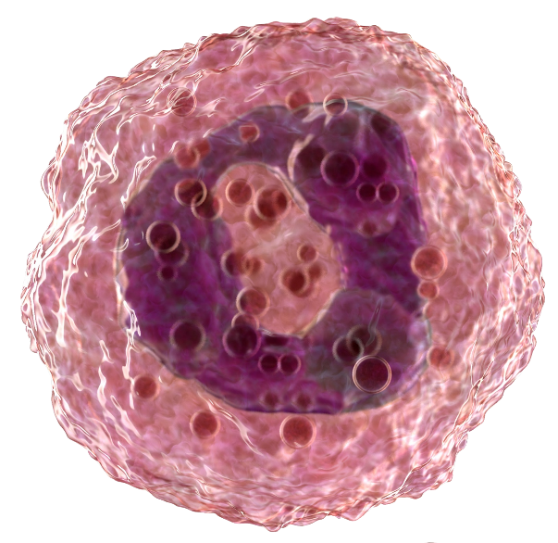
Murine Inflammatory vs Resident Lung Eosinophils: Morphologically and Phenotypically Different
MURINE
 |  | Inflammatory eosinophils | Resident eosinophils
Morphology | Nucleus | Segmented | Ring-shaped
 | Granules | Dense; no degranulation | Variable density; piecemeal (gradual) degranulation
Surface phenotype | Siglec-F | High levels | Intermediate levels
 | CD62L | Absent | Present
 | CD101 | High levels | Low levels
Mesnil C, et al. J Clin Invest. 2016;126(9):3279-3295.
Return to presentation
Notes:
Key points:
Murine inflammatory and resident lung eosinophils are morphologically and phenotypically different¹:
Differences in morphology including the nucleus and granules
Differences in the surface phenotype including Siglec-F, CD62L, and CD101
CD62L (also known as L-selectin) is a cell adhesion molecule which binds a number of glycosylated, fucosylated, sulfated sialylated glycoproteins including CD34, glycam-1 and MAdCam-1^{1,2}
CD101 (also known as immunoglobulin superfamily, member 2 (IGSF2) and V7) is a transmembrane glycoprotein containing 7 Ig-like IgV domains and a short cytoplasmic tail with several phosphorylation sites³
Siglec-F (also known as CD170) is a cell surface lectin belonging to the Ig superfamily that binds glycoconjugates containing sialic acids that are commonly found on various cell types⁴
Note to Presenter: Click on ‘Return to Presentation’ text box at bottom right corner to return to original slide.
References:
Mesnil C, Raulier S, Paulissen G, et al. Lung-resident eosinophils represent a distinct regulatory eosinophil subset. J Clin Invest. 2016;126(9):3279-3295.
ThermoFisher Scientific. CD62L (L-Selectin) Monoclonal Antibody (MEL-14), PE, eBioscience™. https://www.thermofisher.com/antibody/product/CD62L-L-Selectin-Antibody-clone-MEL-14-Monoclonal/12-0621-82. Accessed April 17, 2019.
ThermoFisher Scientific. CD101 Monoclonal Antibody (Moushi101), PE, eBioscience™. https://www.thermofisher.com/antibody/product/CD101-Antibody-clone-Moushi101-Monoclonal/12-1011-82. Accessed April 17, 2019.
ThermoFisher Scientific. CD170 (Siglec F) Monoclonal Antibody (1RNM44N), PE, eBioscience™. https://www.thermofisher.com/antibody/product/CD170-Siglec-F-Antibody-clone-1RNM44N-Monoclonal/12-1702-82. Accessed April 17, 2019.

Slide 23
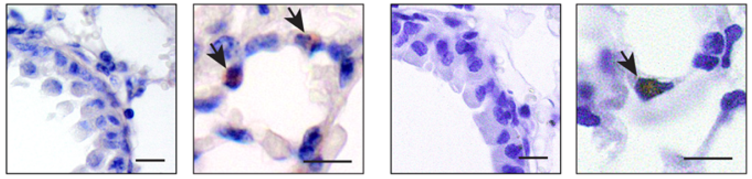
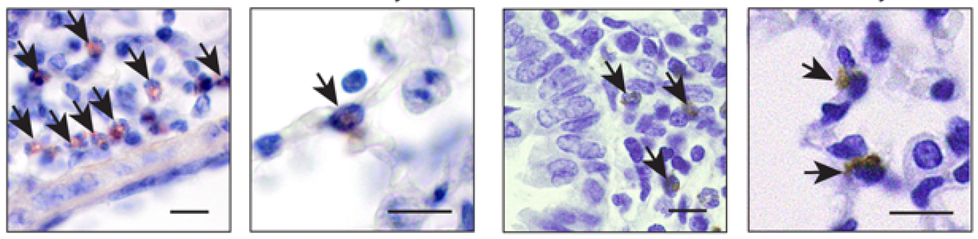
Murine Inflammatory vs Resident Lung Eosinophils: Positionally Different
MURINE
 |  | Inflammatory eosinophils |  | Resident eosinophils
 |  | Congo red | MBP | Congo red | MBP
Location | Steady state
 | Induced allergy*
 |  | Mainly peribronchial |  | Mainly parenchymal
*Induced allergy: effector phase of house dust mite-induced airway allergy; MBP = major basic protein; arrows indicate Congo red- and MBP-positive eosinophils.
Mesnil C, et al. J Clin Invest. 2016;126(9):3279-3295.
Return to presentation
Notes:
Key points:
Murine inflammatory and resident lung eosinophils are positionally different
Inflammatory eosinophils are mainly peribronchial
Resident eosinophils are mainly parenchymal
Note to Presenter: Click on ‘Return to Presentation’ text box at bottom right corner to return to original slide.
Reference:
Mesnil C, Raulier S, Paulissen G, et al. Lung-resident eosinophils represent a distinct regulatory eosinophil subset. J Clin Invest. 2016;126(9):3279-3295.

Slide 24
Murine Inflammatory vs Resident Lung Eosinophils: Different Gene Expression Profile
MURINE
 |  | Inflammatory eosinophils | Resident eosinophils
Differentially expressed genes
Functional difference in gene expression |  | Proinflammatory | Negative regulation of immune responses Tissue homeostasis
Resident eosinophils (steady state)
Upregulated: 88
171
Inflammatory eosinophils
Upregulated: 83
Upregulated genes:
Anxa1
Nedd4
Runx3
Serpinb1a
Ldlr
DIFFERENTIALLY EXPRESSED GENES
0
Upregulated: 93
Resident eosinophils (induced allergy*)
Upregulated genes:
Slc3a2 Tlr4 C3ar1
Il13ra1
Il6
161
Upregulated: 68
*Induced allergy: effector phase of house dust mite-induced airway allergy.
Mesnil C, et al. J Clin Invest. 2016;126(9):3279-3295.
Return to presentation
Notes:
Key points:
Murine inflammatory and resident lung eosinophils have a different gene expression profile¹
Significant differences in gene expression were observed between inflammatory and resident eosinophils regardless of state (P<0.01)
Inflammatory eosinophils had upregulated expression of proinflammatory genes (Slc3a2, Tlr4, C3ar1, Il13ra1, Il6)
Resident eosinophils had upregulated expression of genes involved in the negative regulation of immune responses and tissue homeostasis (Anxa1, Nedd4, Runx3, Serpinb1a, Ldlr)
Not a single gene was differentially expressed between resident eosinophils in the steady state vs during an induced allergy
Note to Presenter: Click on ‘Return to Presentation’ text box at bottom right corner to return to original slide.
Reference:
Mesnil C, Raulier S, Paulissen G, et al. Lung-resident eosinophils represent a distinct regulatory eosinophil subset. J Clin Invest. 2016;126(9):3279-3295.

Slide 25
Murine Inflammatory vs Resident Lung Eosinophils: Different Response to Allergic Inflammation
MURINE
 |  | Inflammatory eosinophils | Resident eosinophils
Cell numbers
 |  | Significant increase (recruitment of inflammatory eosinophils into the peribronchial area) | Unchanged (no change in resident eosinophils in the parenchymal)
Impact of allergic inflammation on phenotype |  | High level of Siglec-F and positive for F4/80 and CCR3 | Not affected by allergic inflammation (unchanged levels of Siglec-F, CD125, F4/80, and CCR3)
6.0
P<0.001
P<0.001
5.0
4.0
3.0
Cell numbers/lung (x10⁶)
1.5
1.0
(P=NS)
Unchanged
0.5
0.0
Steady state
Induced allergy*
Steady state
Induced allergy*
*Induced allergy: effector phase of house dust mite-induced airway allergy.
Mesnil C, et al. J Clin Invest. 2016;126(9):3279-3295.
Return to presentation
Notes:
Key points:
Murine inflammatory and resident lung eosinophils have a different response to allergic inflammation
There was a significant increase in the recruitment of inflammatory eosinophils into the peribronchial area in response to an induced allergy (P<0.001)
Resident eosinophils remained unchanged in response to an induced allergy
Note to Presenter: Click on ‘Return to Presentation’ text box at bottom right corner to return to original slide.
Reference:
Mesnil C, Raulier S, Paulissen G, et al. Lung-resident eosinophils represent a distinct regulatory eosinophil subset. J Clin Invest. 2016;126(9):3279-3295.

Slide 26
Murine Inflammatory vs Resident Lung Eosinophils: Different Response to Anti-IL-5 Antibody
MURINE
 |  | Inflammatory eosinophils | Resident eosinophils
Cell numbers
 |  | Anti-IL-5 antibody significantly inhibited lung inflammatory eosinophils | Anti-IL-5 antibody did not impact lung resident eosinophils
Impact of IL-5 |  | Dependent on IL-5 | IL-5 independent†
8.0
Induced allergy*
Steady state
Induced allergy*
P<0.001
6.0
4.0
Cell numbers/lung (x10⁶)
(P=NS)
Unchanged
(P=NS)
Unchanged
2.0
0.0
Isotype
α-IL-5
Isotype
α-IL-5
Isotype
α-IL-5
*Induced allergy: effector phase of house dust mite-induced airway allergy.
†Data from in vivo experiments indicate that the presence of lung resident eosinophils and blood resident-like eosinophils are independent of IL-5, even though resident eosinophils can respond to recombinant IL-5 in vitro.
Mesnil C, et al. J Clin Invest. 2016;126(9):3279-3295.
Return to presentation
Notes:
Key points:
Murine inflammatory and resident lung eosinophils have a different response to anti-IL-5 antibody
Anti-IL-5 antibody significantly inhibited lung inflammatory eosinophils
Anti-IL-5 antibody did not impact lung resident eosinophils
Inflammatory eosinophils are dependent on IL-5 whereas resident eosinophils are IL-5 independent
Note to Presenter: Click on ‘Return to Presentation’ text box at bottom right corner to return to original slide.
Reference:
Mesnil C, Raulier S, Paulissen G, et al. Lung-resident eosinophils represent a distinct regulatory eosinophil subset. J Clin Invest. 2016;126(9):3279-3295.

Slide 27
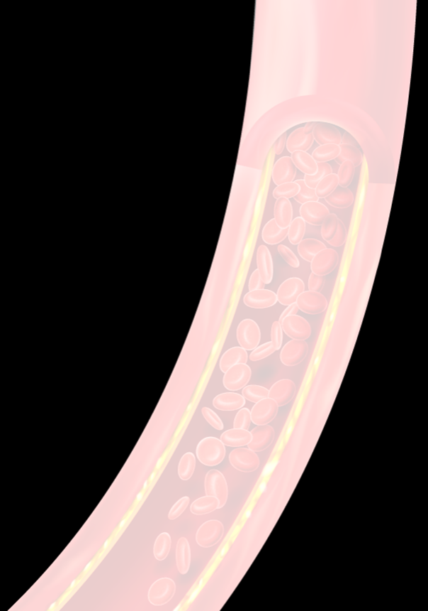
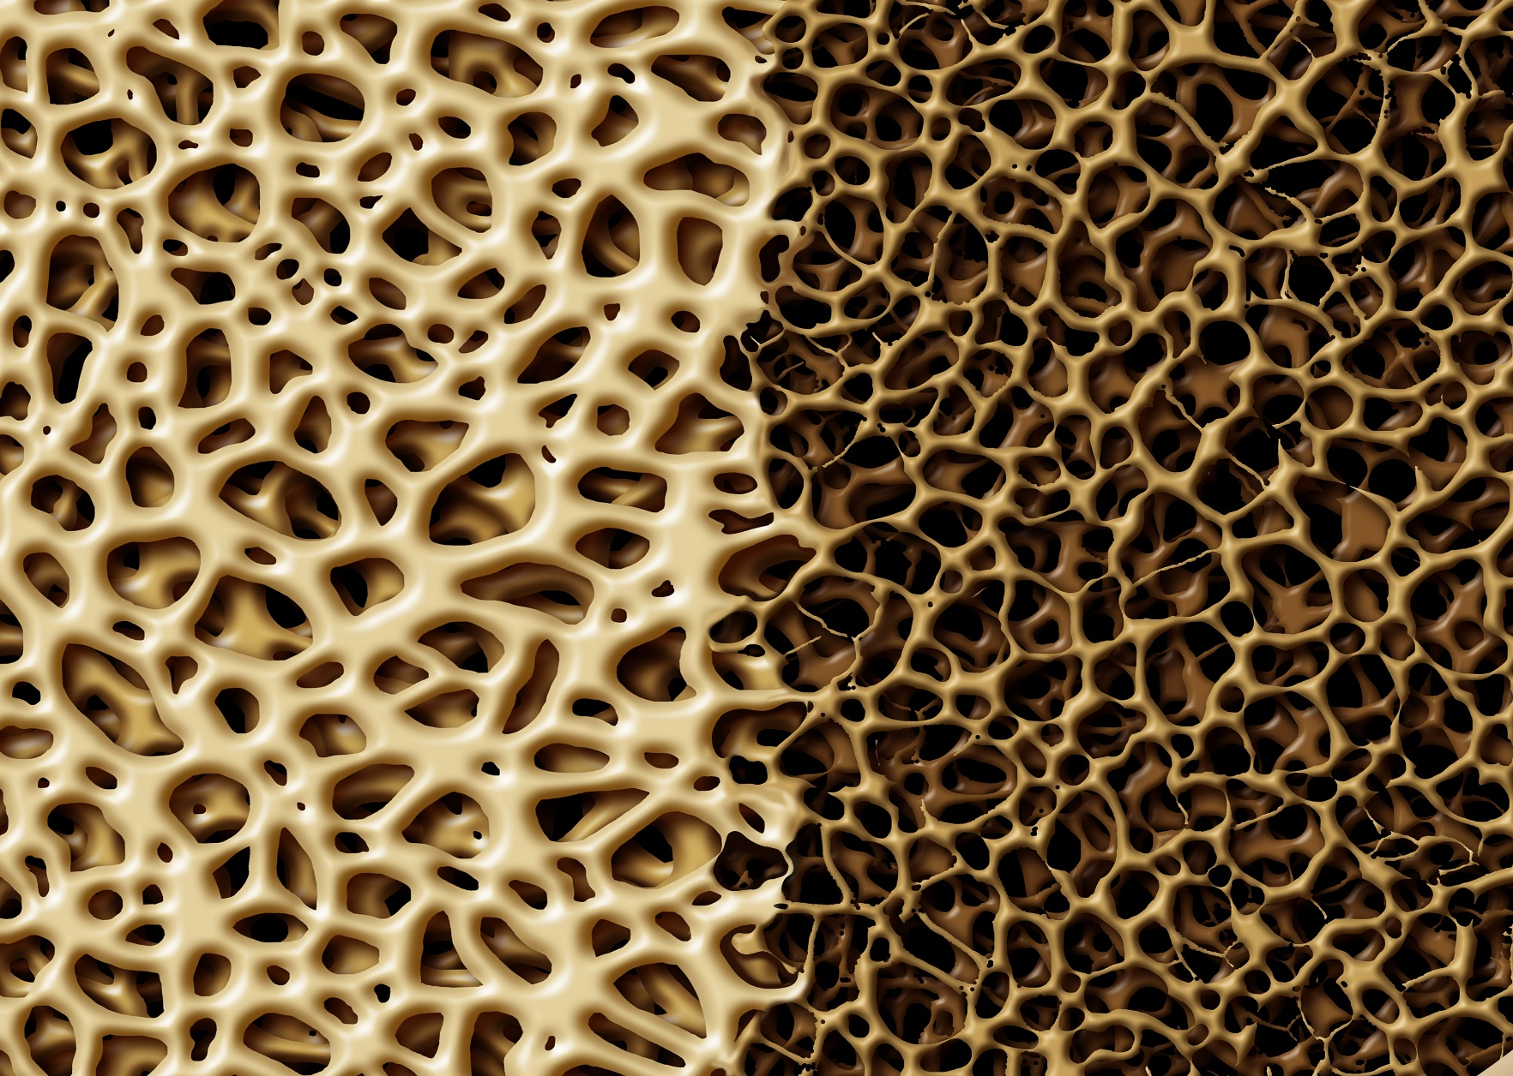

Murine Inflammatory vs Resident Lung Eosinophils: Different Driver of Eosinophil Recruitment
MURINE
INFLAMMATORY EOSINOPHILS
IL-5
dependent
RESIDENT EOSINOPHILS
Injection of recombinant IL-5 had no affect on the recruitment of resident eosinophils in the blood and the lungs respectively
IL-5
independent
Mesnil C, et al. J Clin Invest. 2016;126(9):3279-3295.
Notes:
Key points:
Murine inflammatory and resident lung eosinophils have different drivers of recruitment
Inflammatory eosinophils are dependent on IL-5 whereas resident eosinophils are IL-5 independent, even though resident eosinophils express intermediate levels of the IL-5 receptor
Injection of recombinant IL-5 had no affect on the recruitment of resident eosinophils in the blood and the lungs respectively
Reference:
Mesnil C, Raulier S, Paulissen G, et al. Lung-resident eosinophils represent a distinct regulatory eosinophil subset. J Clin Invest. 2016;126(9):3279-3295.

Slide 28
Murine Inflammatory vs Resident Lung Eosinophils: Different Functional Role
MURINE
 |  | IL-4 | IL-5 | IL-13
Cell numbers
Functional role of resident eosinophils |  | Allergen exposure in the absence of resident eosinophils results in a significant increase in proinflammatory cytokines (IL-4, IL-5, and IL-13)
P<0.01
P<0.01
P<0.01
P<0.001
150
600
P<0.01
2500
P<0.001
P<0.05
P<0.01
2000
100
P<0.01
400
1500
Cytokine concentration (pg/mL)
1000
50
NS
200
NS
NS
500
0
0
0
Control‡ (steady state)
Control‡ (allergy*)
Control (allergy*)‡ + isotype
Control (allergy*) + α-IL-5‡
No eos† (steady state)
No eos† (allergy*)
*Induced allergy: effector phase of house dust mite-induced airway allergy. †Eosinophil deficient (ΔdblGATA mice). ‡Controls were inflammatory eosinophil depleted WT mice.
NS = not significant; eos = eosinophil.
Mesnil C, et al. J Clin Invest. 2016;126(9):3279-3295.
Return to presentation
Notes:
Key points:
Murine inflammatory and resident lung eosinophils have a different functional role¹
Allergen exposure in the absence of resident eosinophils results in a significant increase in proinflammatory cytokines (IL-4, IL-5, and IL-13)
Note to Presenter: Click on ‘Return to Presentation’ text box at bottom right corner to return to original slide.
Reference:
Mesnil C, Raulier S, Paulissen G, et al. Lung-resident eosinophils represent a distinct regulatory eosinophil subset. J Clin Invest. 2016;126(9):3279-3295.

Slide 29
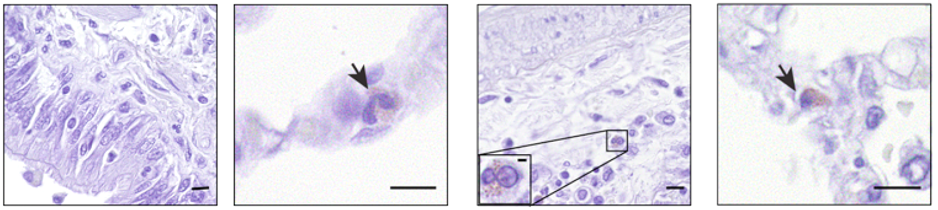
Human Inflammatory vs Parenchymal (Resident?) Lung Eosinophils: Different Localizations and Response to Inflammation
HUMAN
 |  | Peribronchial eosinophils (inflammatory eos?) |  | Parenchymal eosinophils (resident eos?)
 |  | Healthy | Asthma | Healthy | Asthma
Location | Congo red stain
 |  | Mainly peribronchial |  | Mainly parenchymal
Cell numbers The density of resident eosinophils in mouse was similar to the density seen of eosinophils in the parenchyma in humans
4
P<0.01
3
(P=NS)
Unchanged
2
Eosinophil numbers/field
1
Arrows indicate Congo red-positive eosinophils.
Mesnil C, et al. J Clin Invest. 2016;126(9):3279-3295.
0
Healthy
Asthma
Healthy
Asthma
Return to presentation
Notes:
Key points:
Humans have peribronchial and parenchymal lung eosinophils
It remains to be seen whether the parenchymal eosinophils in humans are analogous to murine resident eosinophils
In patients with asthma, the number of peribronchial inflammatory eosinophils significantly increased but the number of parenchymal eosinophils remained unchanged
Note to Presenter: Click on ‘Return to Presentation’ text box at bottom right corner to return to original slide.
Reference:
Mesnil C, Raulier S, Paulissen G, et al. Lung-resident eosinophils represent a distinct regulatory eosinophil subset. J Clin Invest. 2016;126(9):3279-3295.

Slide 30
Human Lung Tissue Eosinophils (putative rEOS) vs Asthmatic Sputum Eosinophils (putative iEOS): Flow cytometric description
HUMAN
 |  | Human Lung Tissue Eosinophils (putative rEOS) | Asthmatic Sputum Eosinophils (putative iEOS)
Surface phenotype | Siglec-8*
 | CD101*
 | CD62L* | Negative | Variable
 | IL-3R | Low levels | High levels
Lung resident eosinophils have not been functionally characterized in humans; however, these data suggest the existence of positionally and phenotypically distinct subsets of lung eosinophils^{1,2}
No difference
No difference
*Human orthologs of the discriminating surface markers found in the mouse.
1. Mesnil C, et al. J Clin Invest. 2016;126(9):3279-3295. 2. Klion A. F1000 Research. 2017;6:(doi:10.12688/f1000research.11133.1).
Return to presentation
Notes:
Key points:
Unlike murine inflammatory and resident eosinophils, human peribronchial and parenchymal lung eosinophils could not be distinguished by morphology¹
Some phenotypic differences were observed in human peribronchial and parenchymal lung eosinophils¹
Siglec-8 (human ortholog of murine Siglec-F)¹:
Unlike the murine model, no differences were noted in humans
CD101 (human ortholog of murine CD101)¹:
Unlike the murine model, no differences were noted in humans
CD62L (human ortholog of murine Siglec-F)¹:
Similar to the murine model, CD62L was absent in peribronchial eosinophils and present in varying levels in parenchymal eosinophils in humans
IL-3R
Was assessed because of previously described mRNA upregulation in blood eosinophils of asthma patients vs. healthy controls¹
Was found to be present in differing levels in human inflammatory eosinophils vs parenchymal eosinophils¹
Lung resident eosinophils have not been functionally characterized in humans; however, these data suggest the existence of positionally and phenotypically distinct subsets of lung eosinophils^{1,2}
Note to Presenter: Click on ‘Return to Presentation’ text box at bottom right corner to return to original slide.
References:
Mesnil C, Raulier S, Paulissen G, et al. Lung-resident eosinophils represent a distinct regulatory eosinophil subset. J Clin Invest. 2016;126(9):3279-3295.
Klion A. Recent advances in understanding eosinophil biology [version 1; referees: 2 approved]. F1000 Research. 2017;6:(doi:10.12688/f1000research.11133.1).

